Slide 1
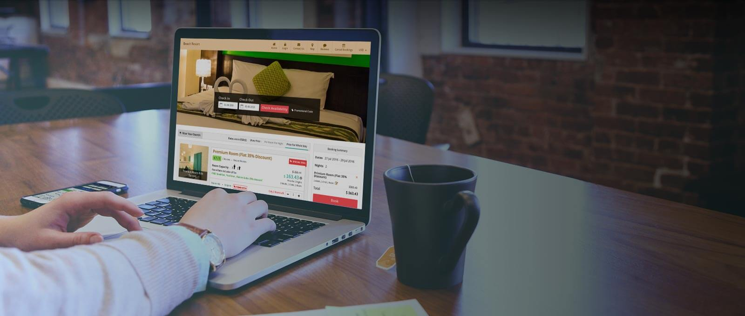


Hotel Booking Management System
IGATE is now a part of Capgemini

Slide 2

TEAM MEMBERS
Amol Hadkar 093942_FS
Bhavana C 093938_FS
Gowtham A 093946_FS
Hrishikesh R Savanur 093956_FS
Mohammed Asik k 093947_FS
Monisha S M 093952_FS
Ramanujam Sivakumar 094002_FS

Slide 3
OVERVIEW OF THE PROJECT
This project is aimed at test an online Hotel Booking Management System (HBMS) for applicants. This is a web based application that can be accessed throughout the web. This system can be used to search a Hotel Rooms for which an applicant wishes to book rooms; Book online rooms for a selected Hotel by logging in and search for hotel, administration staff can add/update/delete any Hotel details. Guest users and Employees can book the room through online.

Slide 4

Actors
Admin
Hotel Employee
Customer

Slide 5
ADMINISTRATOR Workflow
LOGIN
Add Hotel
Update Hotel
Delete Hotel
View Hotel Booking Details
View all requested Hotel
Admin
LOGOUT

Slide 6
User’s Workflow
LOGIN
USER
Searching for Hotel
Book a Hotel
LOGOUT

Slide 7
Employee’s Workflow
LOGIN
Employee
Searching for Hotel
Book a Hotel
LOGOUT

Slide 8
APPLICATION LINK
http://ndafile:8081/Spring_Hotel/login.html

Slide 9

TEST CASES
Testing is a process that helps in finding out how well the product works:
Aimed at finding defects.
Aimed at demonstrating lack of quality.
Aimed at demonstrating the gap between specification and actual product.
Aimed at building faith in the end product that gives advise on quality and risk.

Slide 10


TEST CASES
No. OF Test Passed=226
No. OF Test Cases=257
No. OF Test Failed=31

Slide 11
Test Cases
..\Desktop\Group 2\Test Case(HBMS).xlsx

Slide 12
Requirement Itemization
User-friendly interface.
Mobile-friendly.
Support for multiple language and currencies.
Easy room management( reviews of the room).
Integrated payment Gateway.
Discounts.
Easy search option.

Slide 13
Requirements Validation And Functional Decomposition
File Handling
Storage of information
Termination
End process
Implicit
Efficiency
Invocation
Start process
RVFD
Explicit
User specified
System
Minimum specifications
Security
For confidentiality
Query
improvements
Error Handling
consistency

Slide 14
REQUIREMENTS VALIDATION AND FUNCTIONAL DECOMPOSITION
Admin
Admin Login
Add Hotel
Add Hotel with Flight
Add Hotel with Cab
Update Hotel
Delete Room
Employee
Employee Login
Search Hotel
Book Rooms
Customer
Customer Login
Search Hotel
Book Rooms

Slide 15
REQUIREMENTS VALIDATION AND FUNCTIONAL DECOMPOSITION
..\Desktop\Group 2\RVFD

Slide 16
Use Case
The Use Case is a list of actions or event steps , typically defining the interactions between a role termed as Actor and a System ,to Achieve a goal.
The Actor can be a user or any System.
A use case diagram at its simplest representation between the user and different use cases in which user is involved
A use case diagram can identify the different types of users of a system and the different types of use cases and will be accompanied by other types of diagrams as well

Slide 17
USE CASES
Admin
Admin Login
Add Hotel
Add Hotel with Flight
Add Hotel with Cab
Add Room
Update Hotel
Delete Hotel
Employee
Employee Login
Search Hotel
Book Rooms
Customer
Customer Login
Search Hotel
Book Rooms

Slide 18
USE CASES
..\Desktop\Group 2\Use Case's

Slide 19
Defect Report
The defect report is the most effective manner of communicating, tracking, and explaining defects to managers and development staff.
The more logical, organized, and detailed the report, the more likely a developer can reproduce it without assistance or without having to request more information.
Defect - A problem which, If not corrected could cause an application to either fail or to produce incorrect results.

Slide 20
DEFECT FREE DEFECT REPORT
Admin
Admin Login
Add Hotel
Add Hotel with Flight
Add Hotel with Cab
Update Hotel
Delete Room
Employee
Employee Login
Search Hotel
Book Rooms
Customer
Customer Login
Search Hotel
Book Rooms

Slide 21
DEFECT FREE DEFECT REPORT
..\Desktop\Group 2\DFD\Defect Reporting HBMS.xlsx

Slide 22

OBSERVATION
About UI:
The look and feel is good.
The UI is not localized and user-friendly.
Defects:
The functionalities don’t work as expected.
Pages are not redirected as expected.
Error messages are inappropriate.

Slide 23
OBSERVATION (contd..)
Concern:
Validations need to be prioritized.
Exception handling need to be taken care of.
Response time should be less.
Security:
Password policy should be stringent.
`

Slide 24
Test Case Adequacy :
Test Case Adequacy :
This metrics defines the number of actual test cases created vs. the estimated test cases at the end of the test case preparation phase
Test case Adequacy = (No. of actual test cases*100) / ( No. of test cases estimated)
Test case Adequacy = (257*100)/500
= 51.4

Slide 25
Test Case Effectiveness:
Test Case Effectiveness:
This metrics define the effectiveness of the test cases which is measured in terms of the number of defects found in testing with using the test cases.
Test case effectiveness = No. of Defects found / No. of Test cases executed
Test case effectiveness = 31/257
= 0.12

Slide 26
Traceabililty Matrix
Test Case Id | TDR_ID | BR Id
TC_HBMS_037 | DF_HOTEL_01 | BR_Emp_01
TC_HBMS_047 | DF_HOTEL_03 | BR_Emp_05
TC_HBMS_052 | DF_HOTEL_08 | BR_Emp_06
TC_HBMS_34 | DF_HOTEL_01 | BR_User_01
TC_HBMS_38 | DF_HOTEL_02 | BR_User_03
TC_HBMS_36 | DF_HOTEL_04 | BR_User_01
TC_HBMS_144 | DF_HOTEL_01 | BR_AD_01
TC_HBMS_149 | DF_HOTEL_08 | BR_AD_02
TC_HBMS_207 | DF_HOTEL_05 | BR_AD_04

Slide 27

CONCLUSION
We hereby conclude that the application needs to improve its functionality, validation , security , performance and maintenance issues.

Slide 28


Slide 29
Thank You For Listening…

